Slide 1

UCSD BIOM 262: 3/8/2022
Lecture Notes
Modern Applied Population Genetics
Nicholas J. Schork, Ph.D.
(UCSD, La Jolla, CA; TGen/COH, Phoenix AZ)
Views on Global Human Genetic Variation and Lewontin’s Studies & Fallacy
2. Global Human Functional Genomic Diversity: Stratification and Its Consequences
3. Admixture: Characterization, Consequences and Admixture Mapping
Population Genetics and Evolutionary Genetics: Integration and Impact

Slide 2
1. Views on Global Human Genetic Variation and Lewontin’s Studies/Fallacy

Slide 3
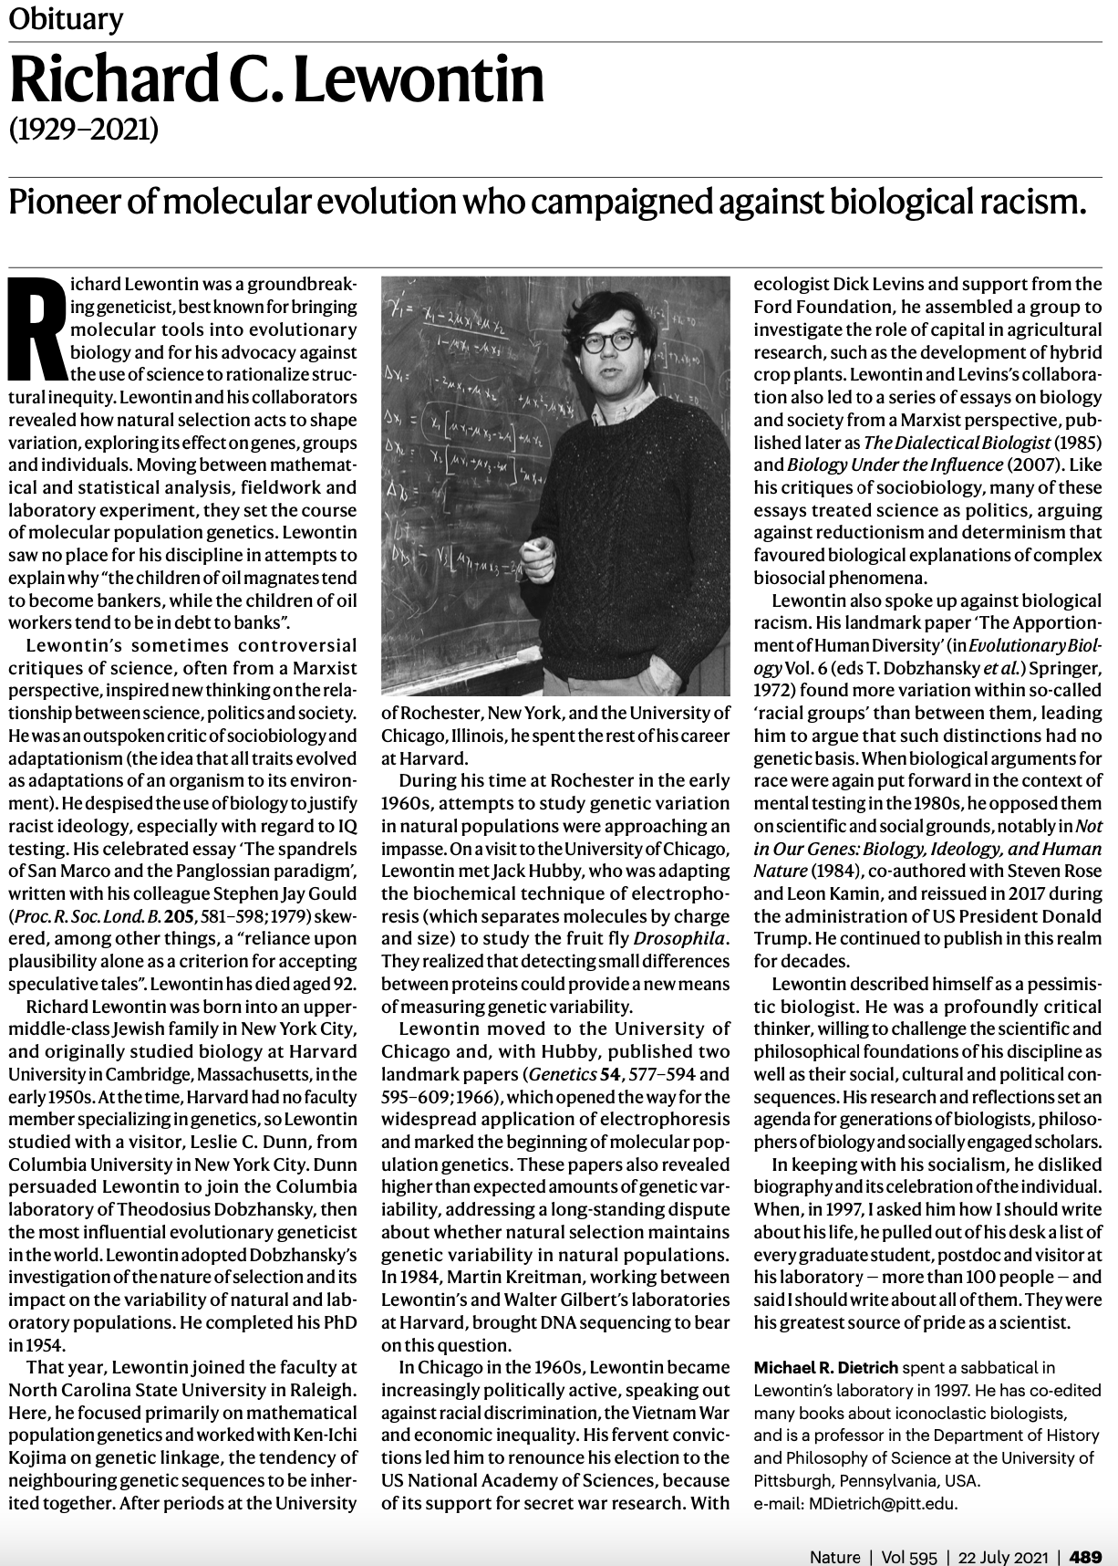
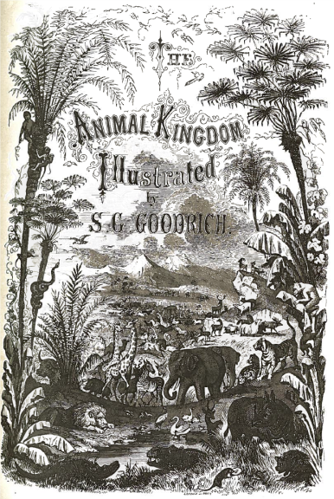
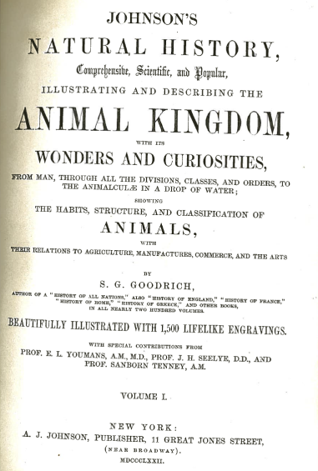
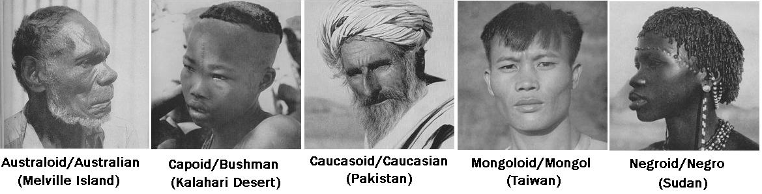
Previous Views on Global Human Genetic Variation and Lewontin’s Study

Slide 4
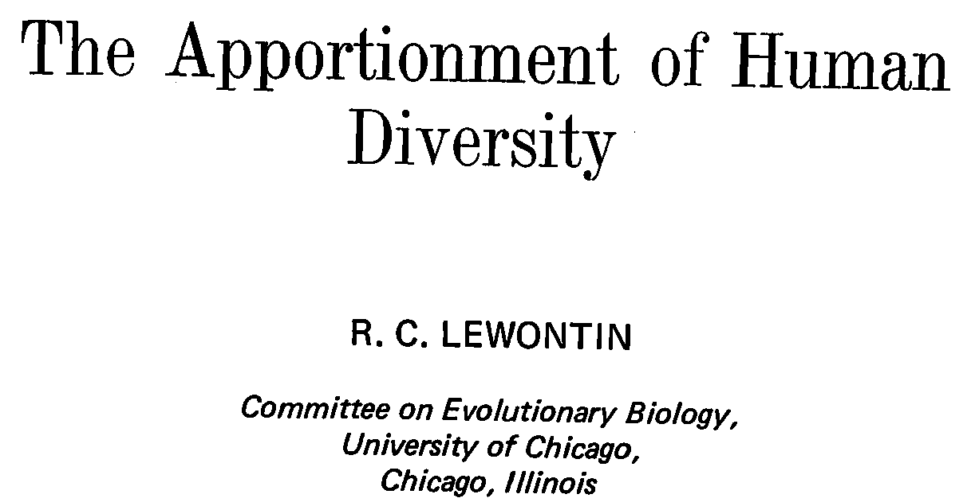
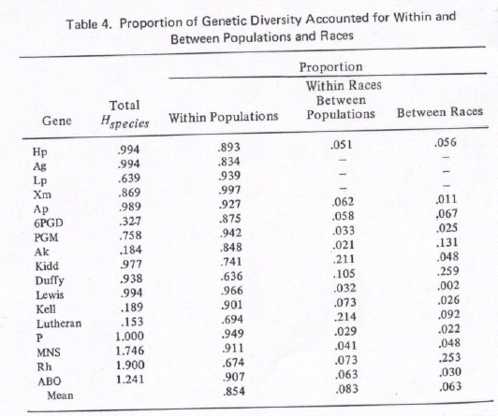
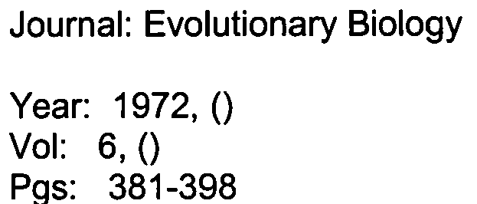
Lewontin’s 1972 Study and Its Implications for Studies of Genetic Variation

Slide 5
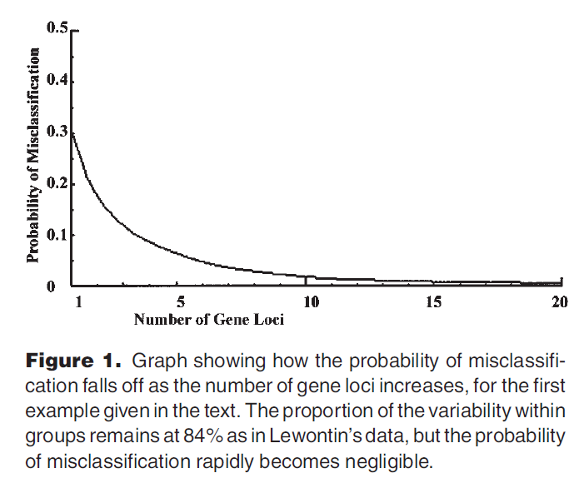
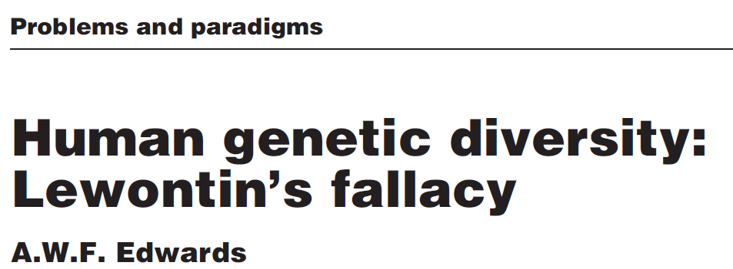
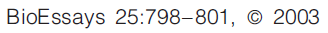
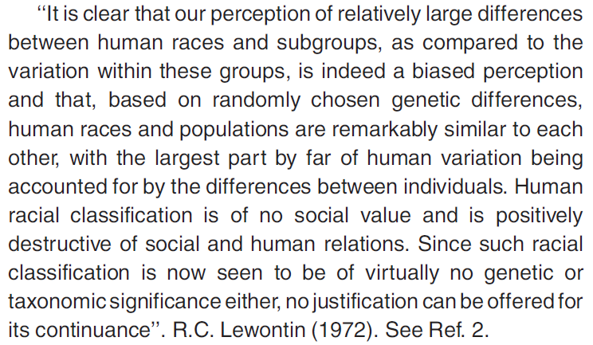
Lewontin’s 15.0% is >0.0%, So Classification is Possible with Enough Loci…

Slide 6
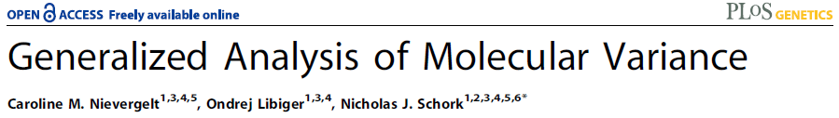
Representing Human Genomic Diversity via Similarity ‘Trees’
Genotype Similarity:
Person 1: AA GG AA CC AA
Person 2: AT GG GA CC CC
6/10=0.60
1 2 1 2 0
N x N Distance Matrix
1 2 3 N
1 0.00 0.76 0.54 … 0.90
2 0.76 0.00 0.43 … 0.63
3 0.54 0.43 0.00 … 0.32
…
N 0.90 … 0.00
Figure 1. Neighbor-joining trees depicting the genetic relationships of 1040 individuals from 51 world populations collected by the HGDP. In figure 1a individuals are color coded according to which of five major geographic regions of the globe they are collected from, and in figure 1b, according to which of the 51 populations they are associated with (key: 1: Biaka Pygmy, 2: San, 3: Mbuti Pygmy, 4: Druze; 5: Bedouin, 6: Mozabite, 7: Palestinian, 8: Kalash, 9: Pima, 10: Columbian, 11: Karitiana, 12: Surui, 13: New Guinea, 14: Yakut).

Slide 7
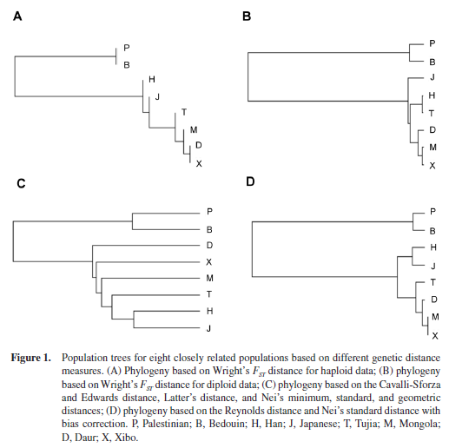
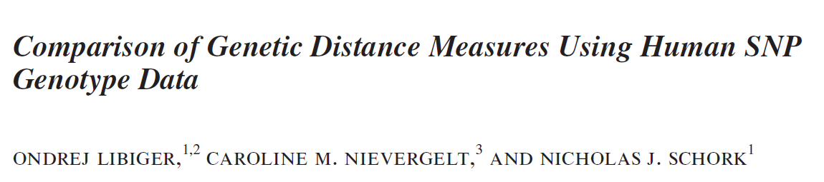
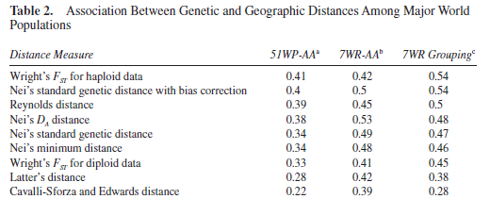
Available Genetic Distance Measures Make Different Assumptions…

Slide 8
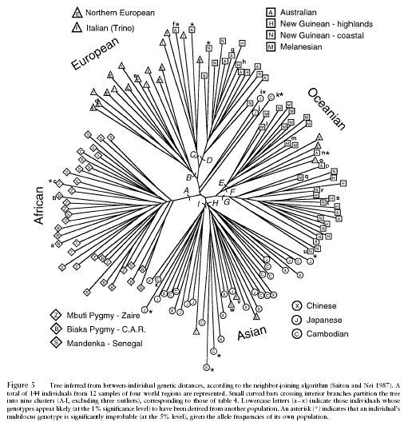
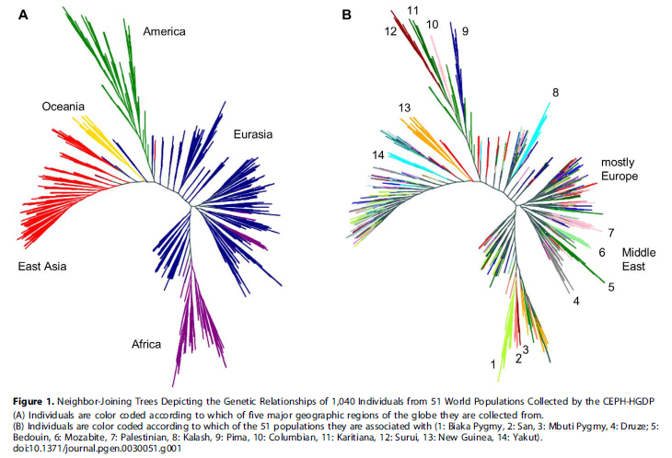
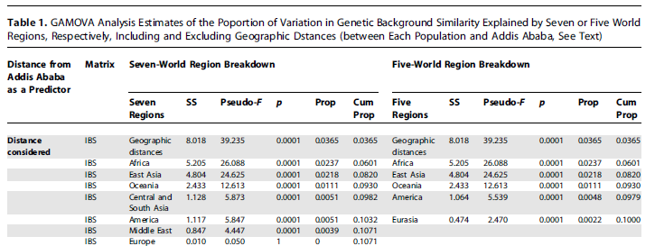
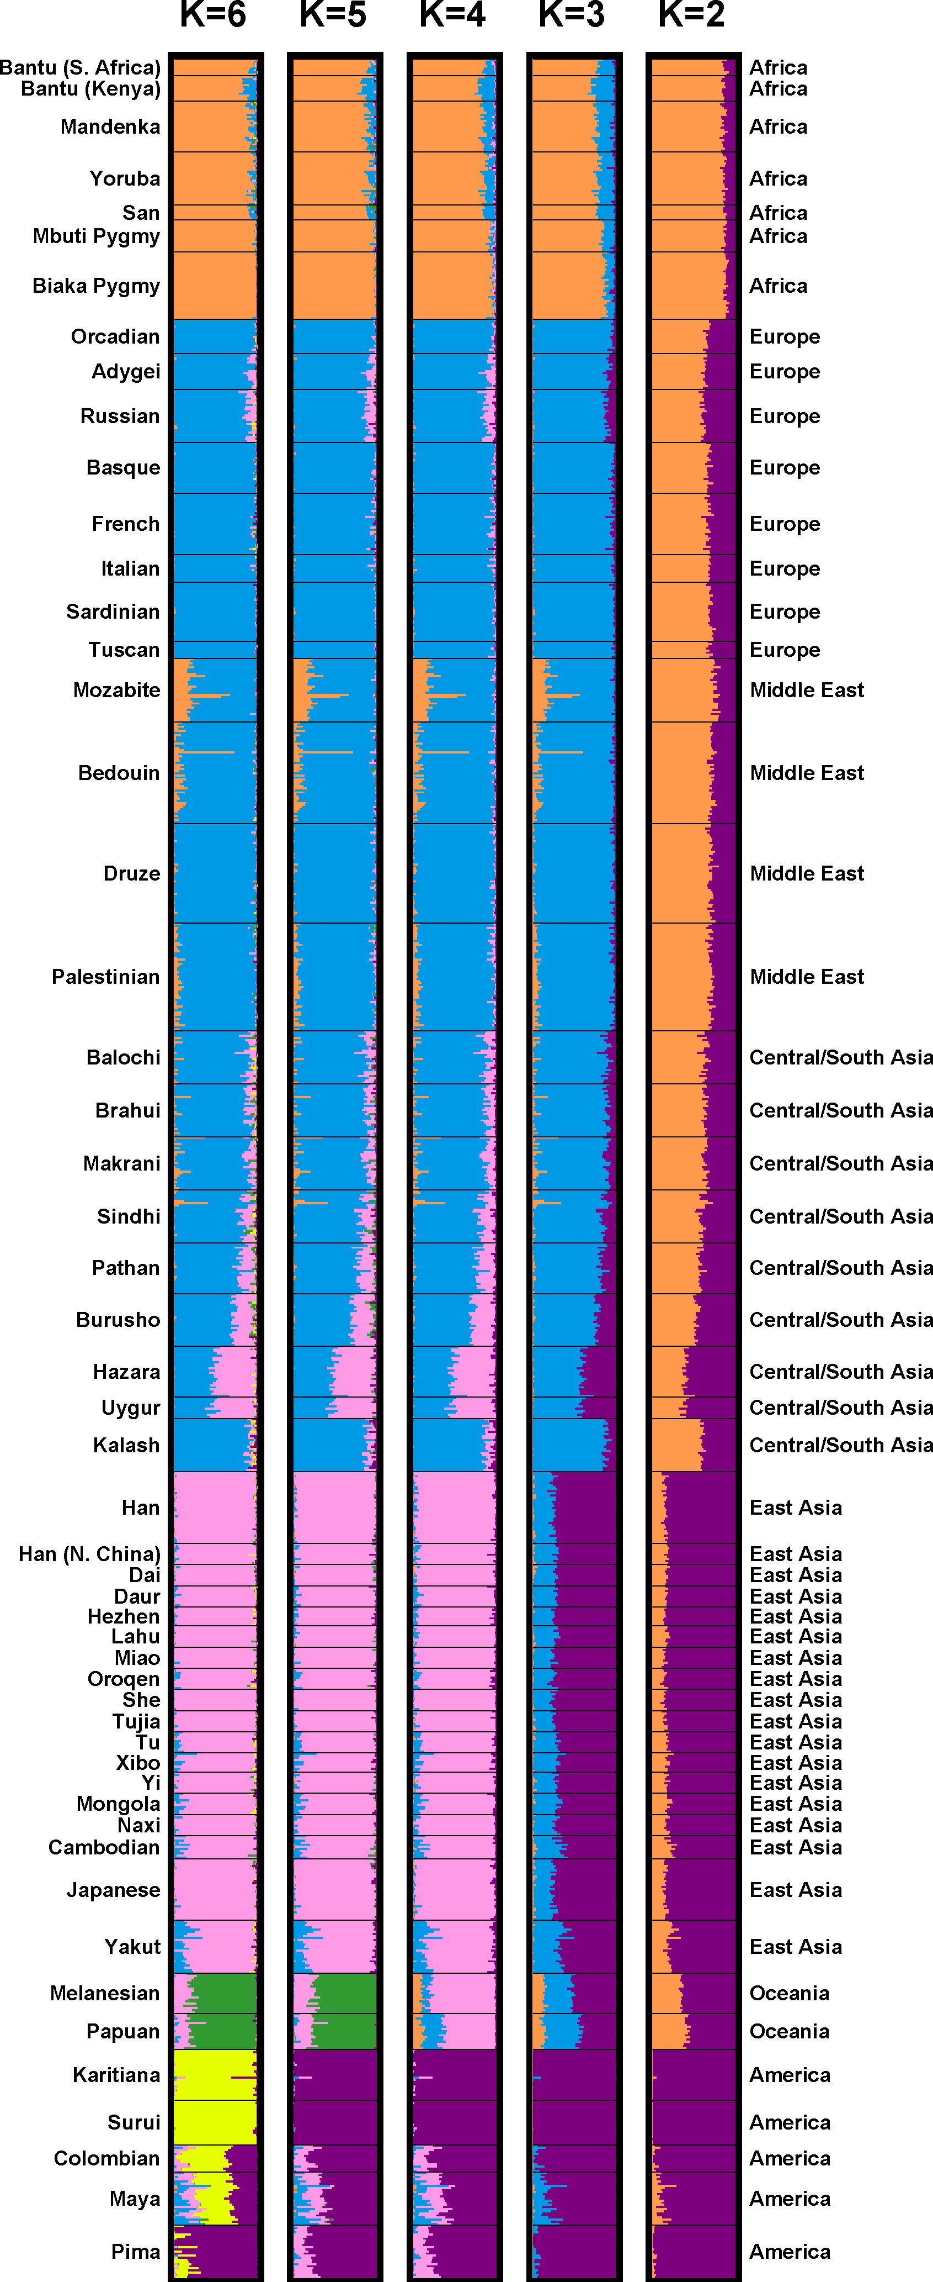
Contemporary ‘Unsupervised’ Studies of Global Human Genetic Diversity
Mountain and Cavalli-Sforza, Am. J. Hum. Genet. 1997
Rosenberg et al. Science 2004

Slide 9
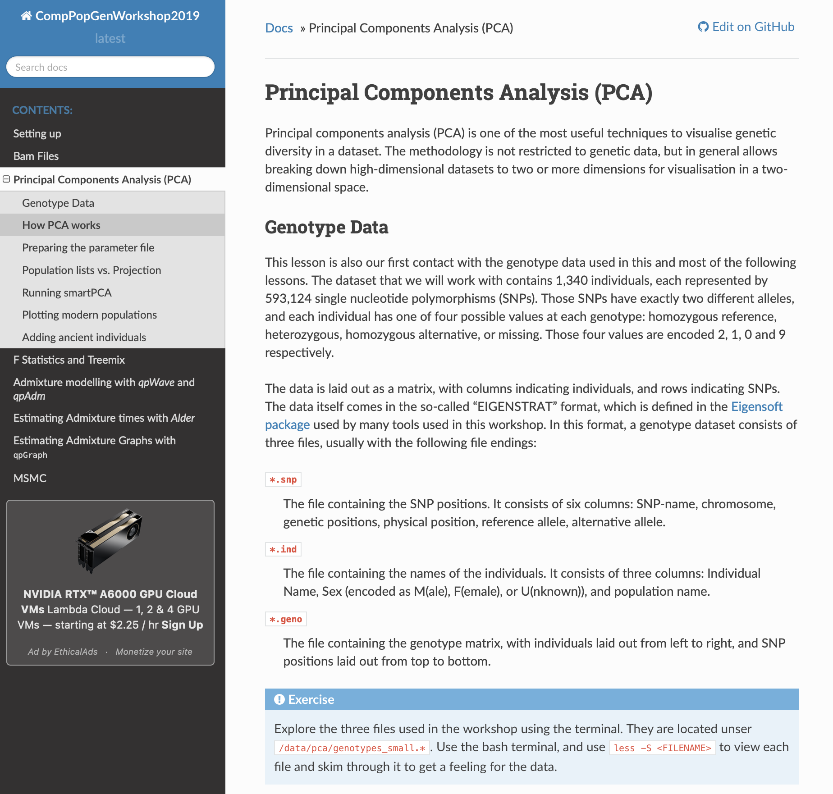
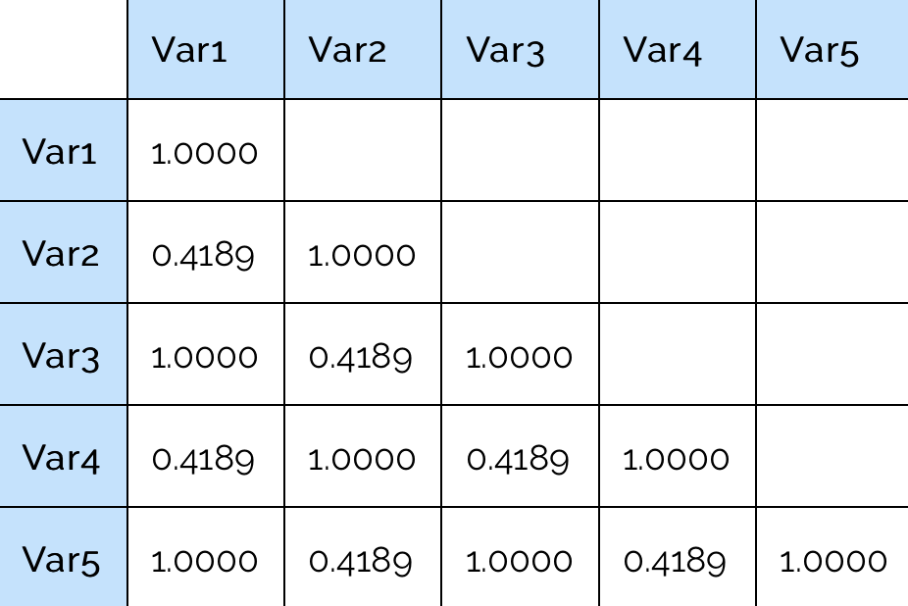
Using Principal Components (PC) Analyses to Uncover Ancestral Groups
Dimension reduction by looking for linear combinations of measures that explain variation in a data set
=P2*0.2+2.0
=P1*1.2-0.3
=P1*0.9+1.0
Only 2 PCs are needed to ‘explain’ variation in the data
https://comppopgenworkshop2019.readthedocs.io/en/latest/contents/03_pca/pca.html#how-pca-works

Slide 10
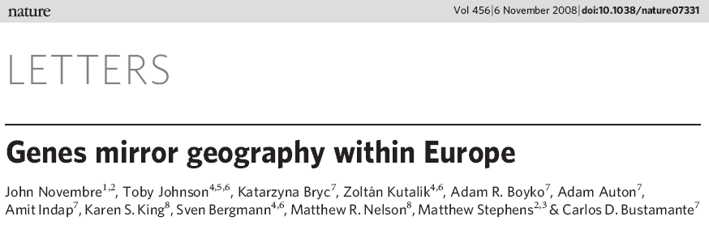
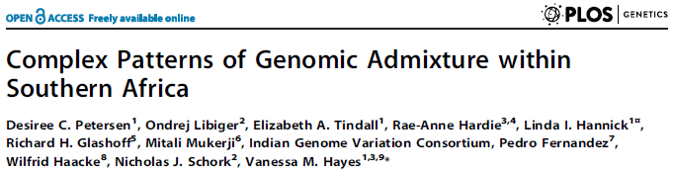
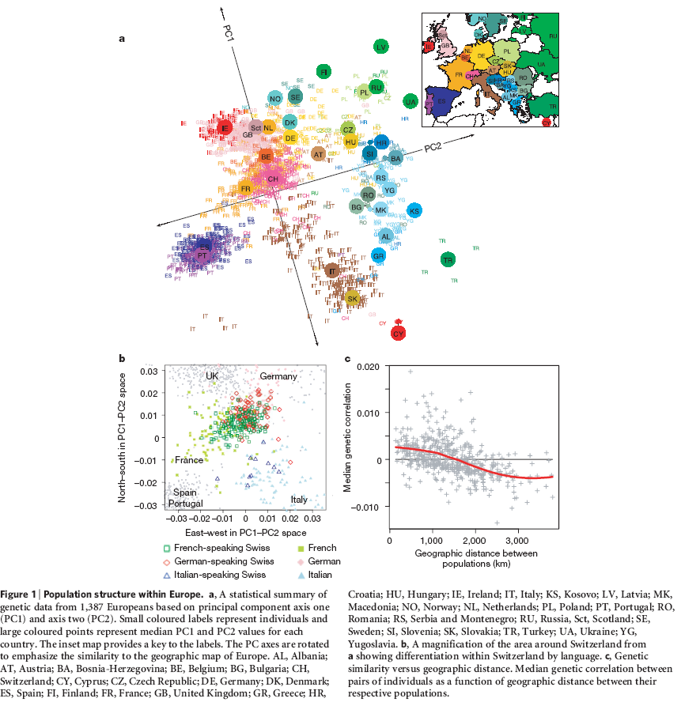
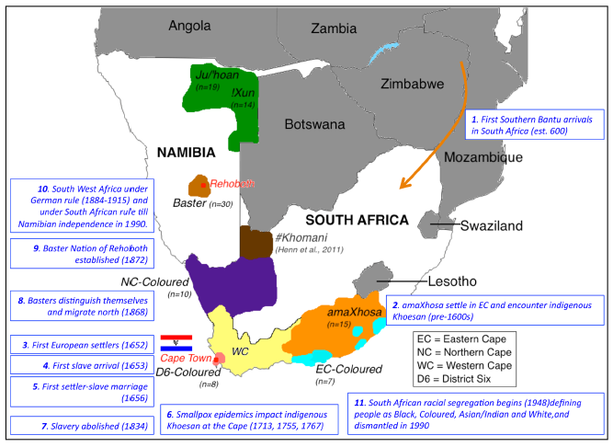
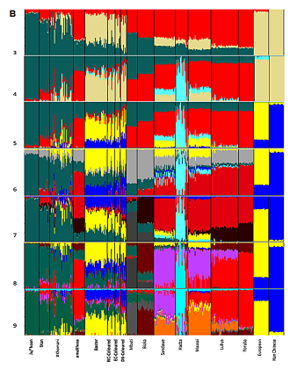
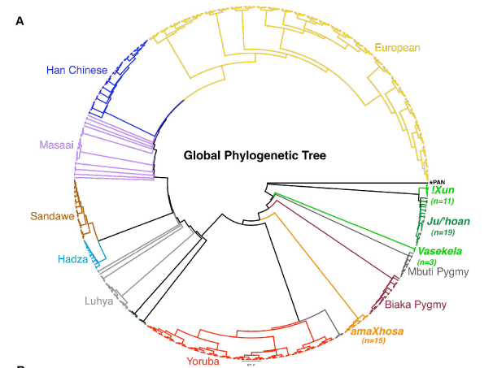
With Enough Markers, Populations Can Be Distinguished

Slide 11
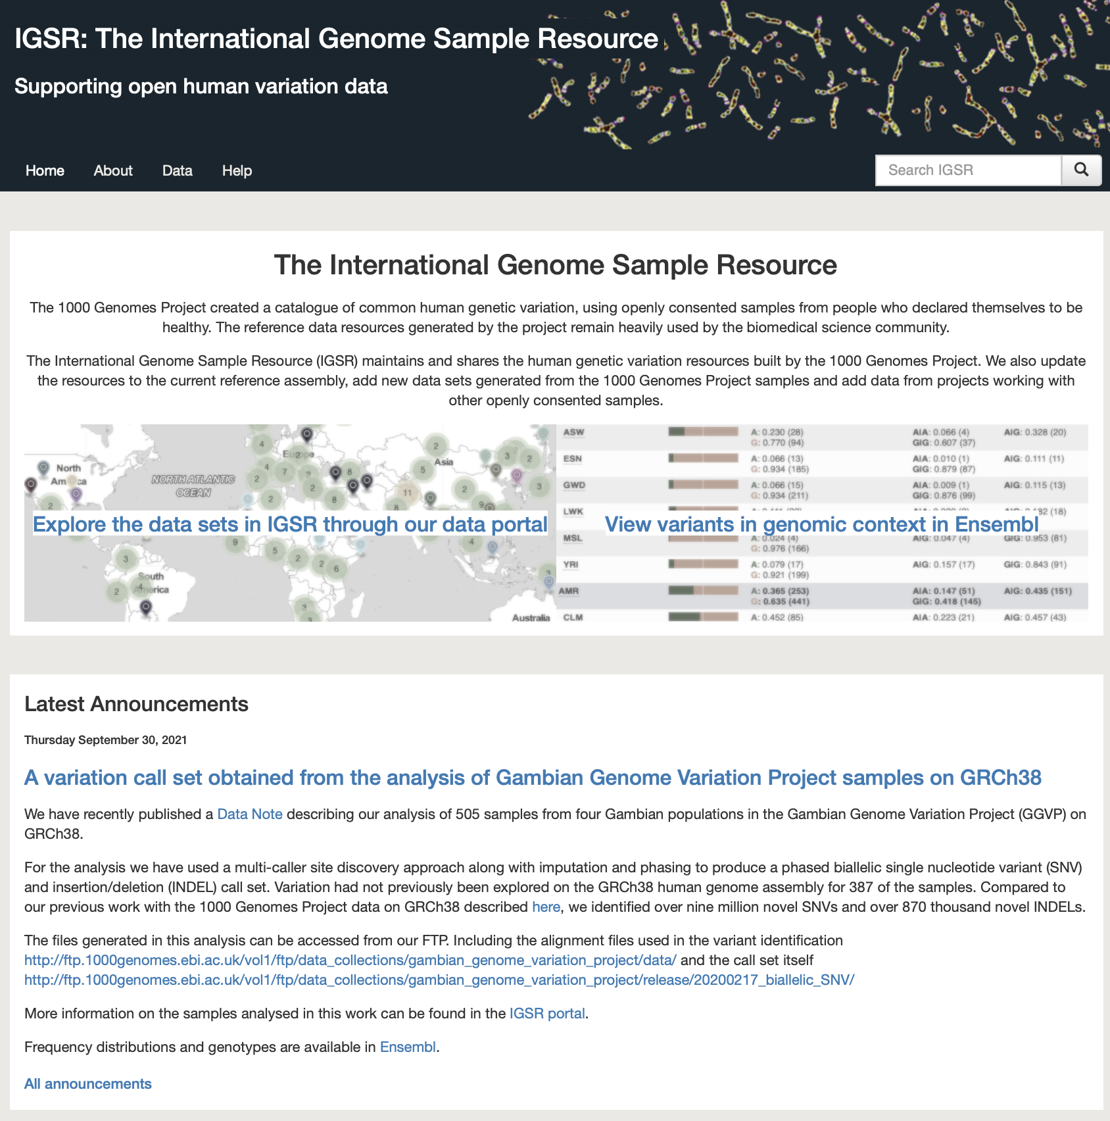
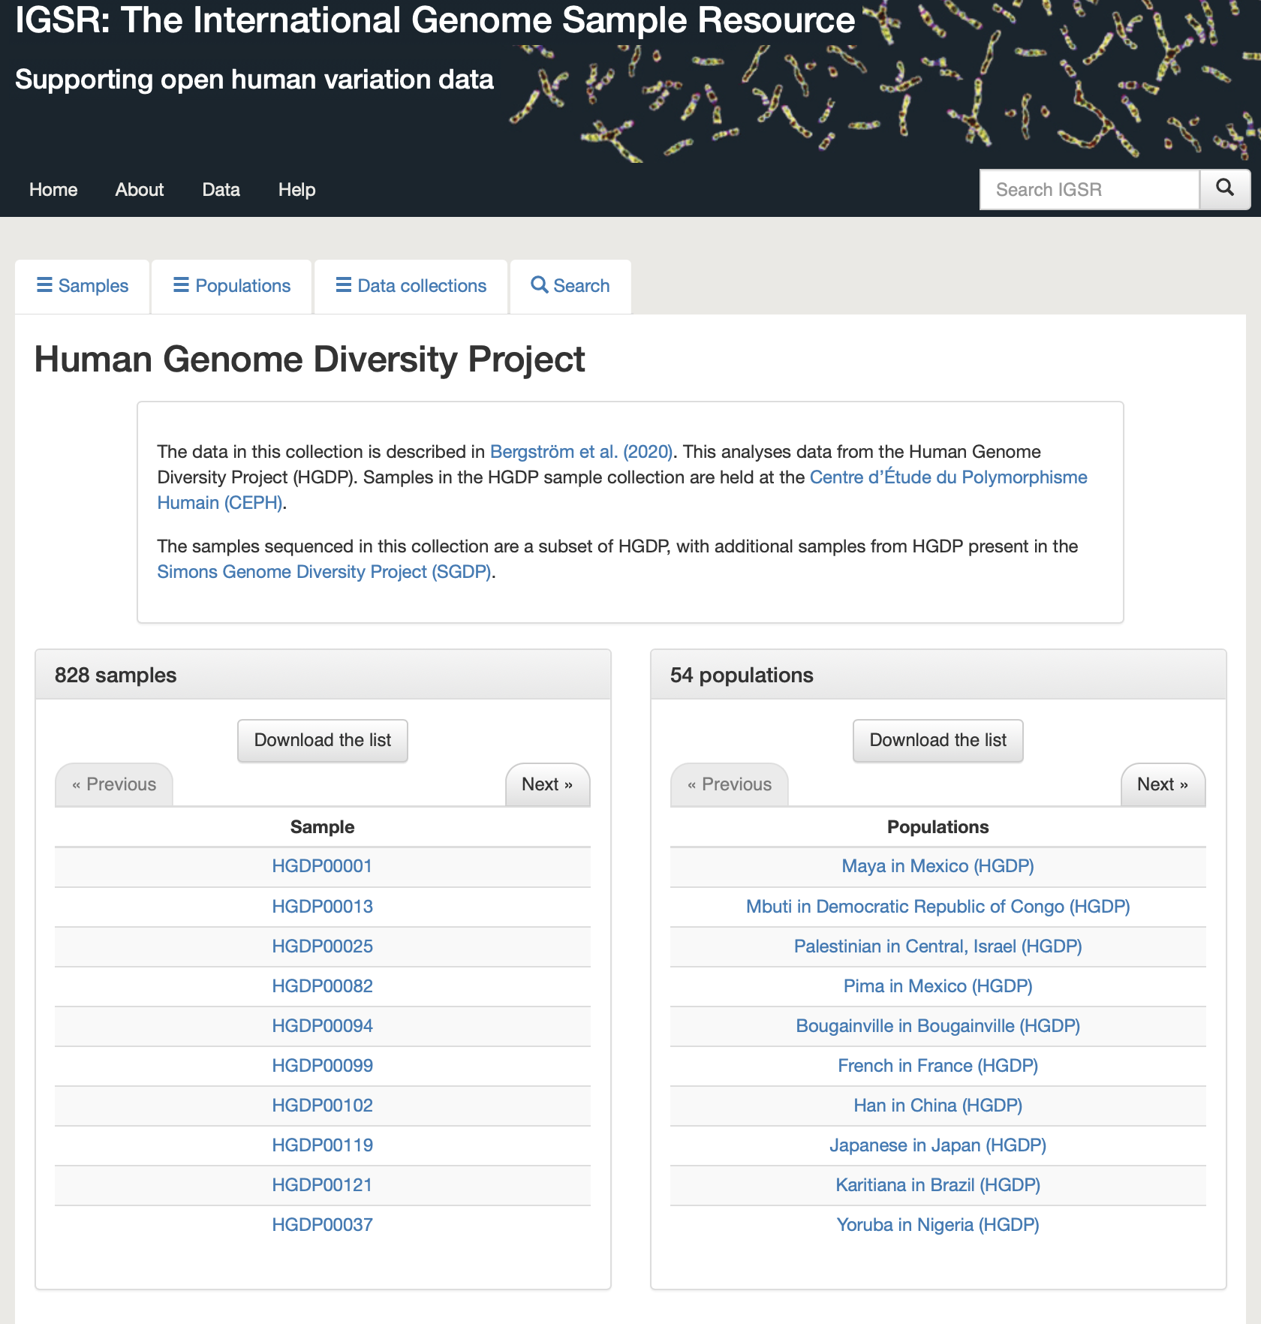
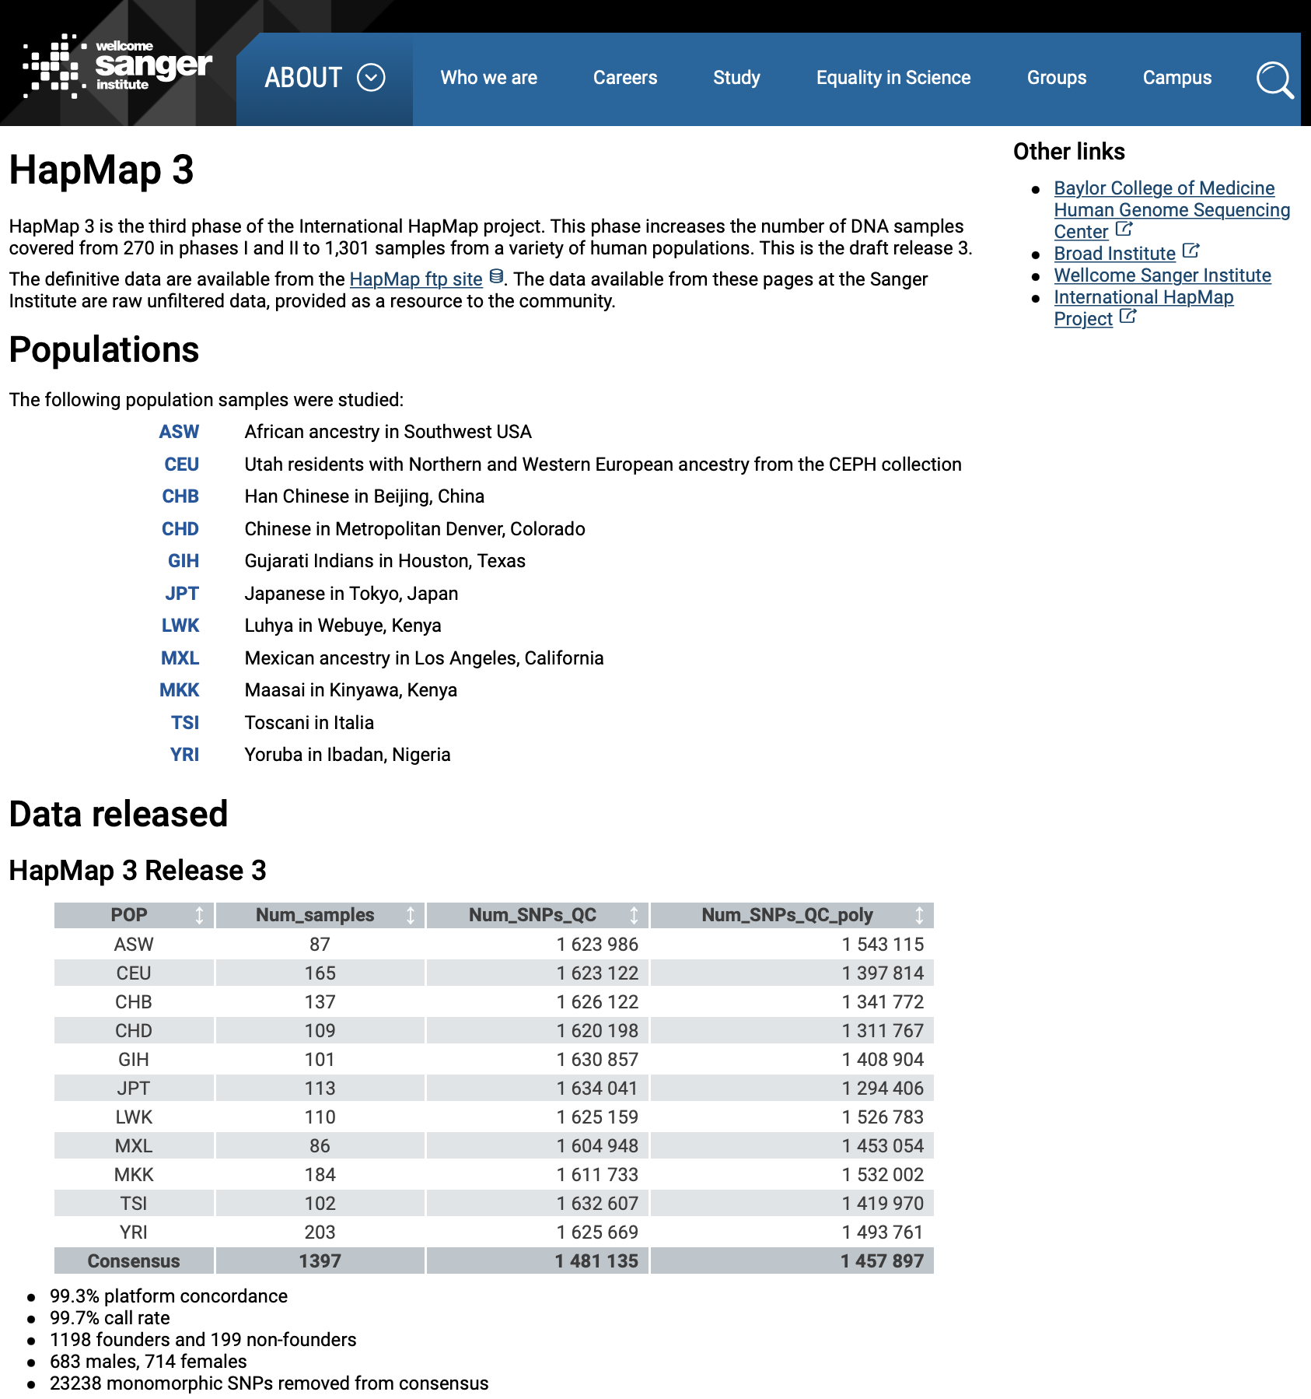
Population-Level Genomic Variant Data Resources

Slide 12
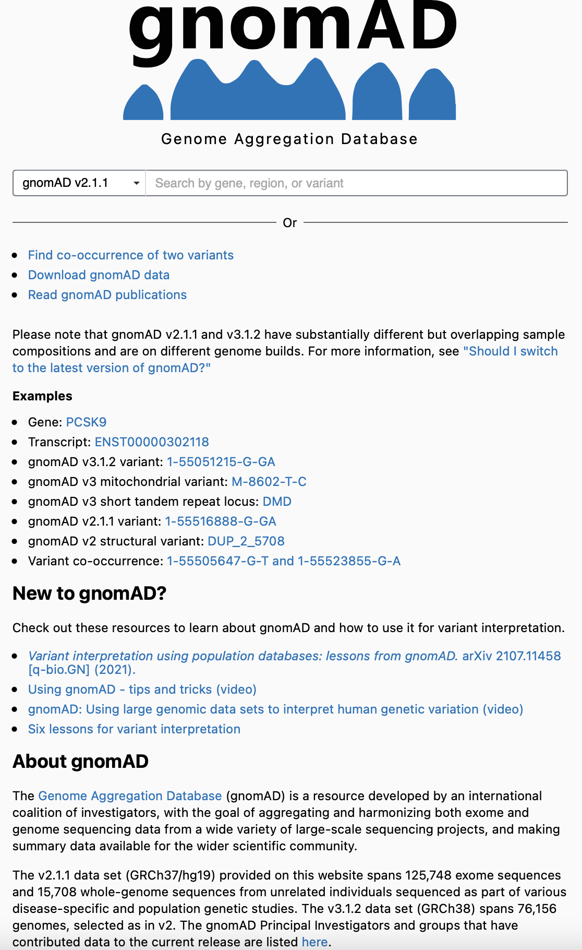
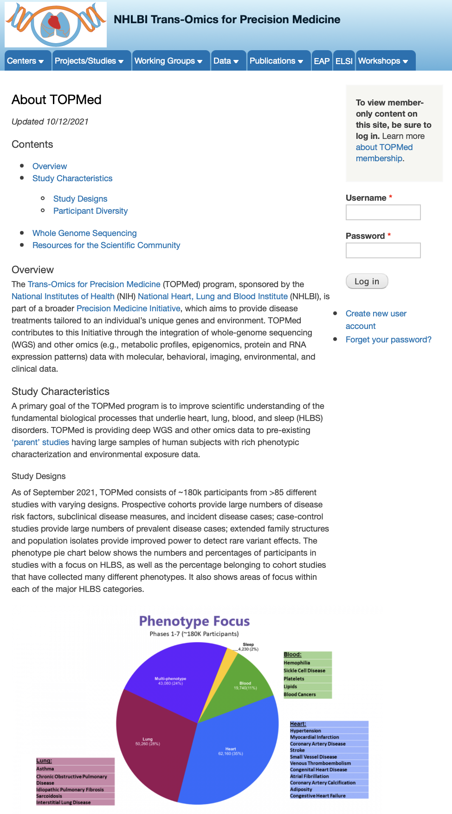

Applied Population-Level Genomic Variant Data Resources

Slide 13
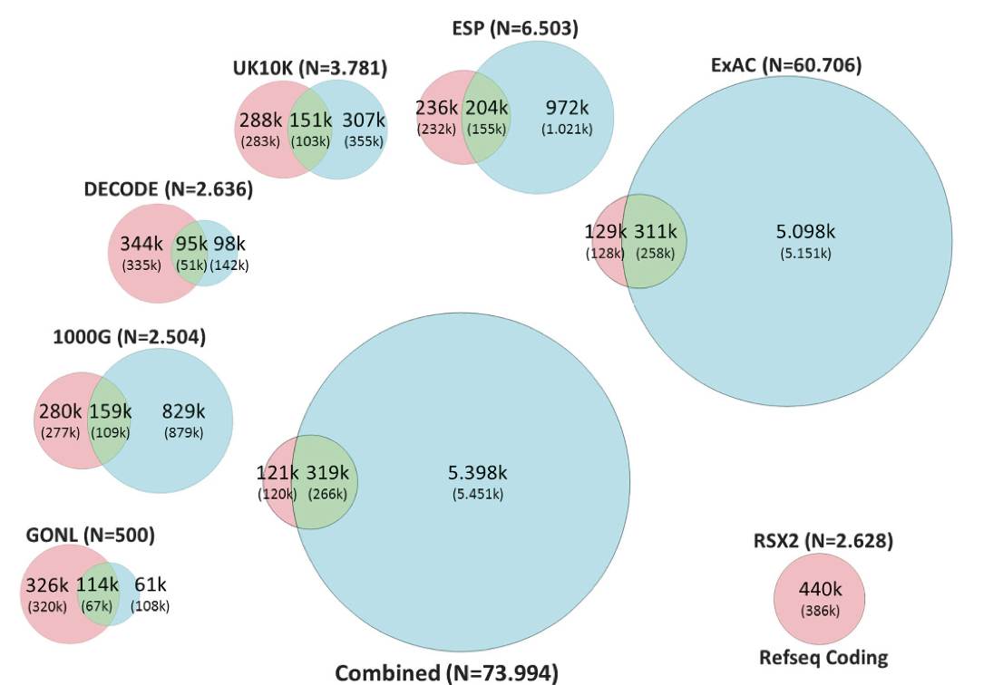
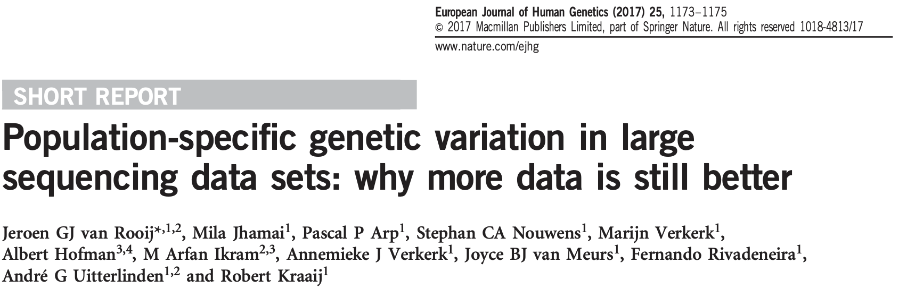
Population-Specific Variants and Differential Variant Frequency

Slide 14
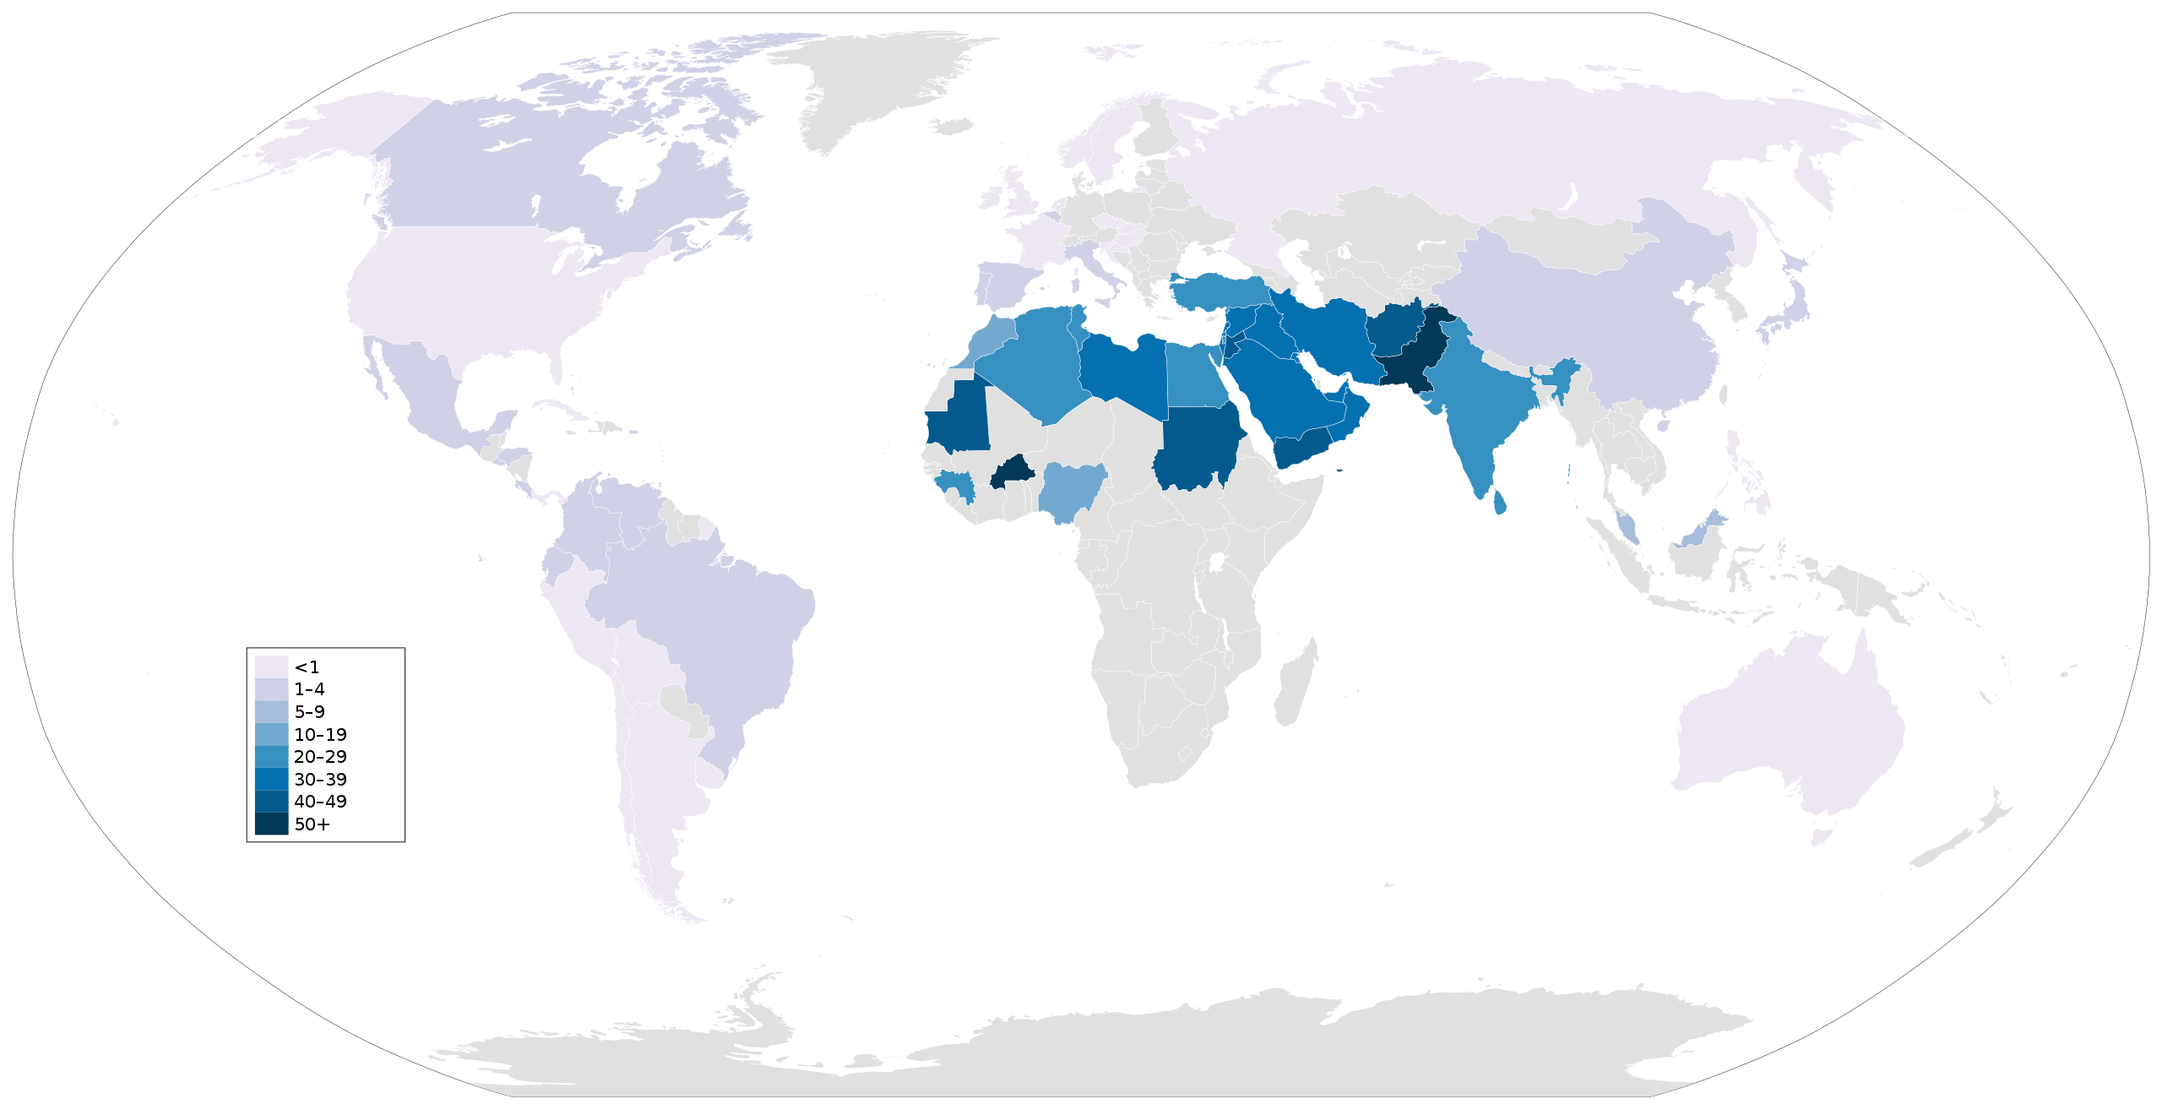
Population Size & Random Inbreeding: Homozygosity and Population-Specificity
Mating among related individuals (inbreeding) results in greater homozygosity
Recessive diseases increase with greater population-level homozygosity
The smaller the population the more likely, purely by chance, two individuals will mate that are related
The greater the homozygosity the smaller the ‘effective’ population size (e.g., if everyone is a clone the effective population size is 1.0)
Populations do not have to be geographically isolated to undergo random inbreeding (e.g., religious isolates)
Isolated populations recycle genes and stay within the population
Global Levels of Consanguinity
https://en.wikipedia.org/wiki/Inbreeding#/media/File:Global_prevalence_of_consanguinity.svg

Slide 15
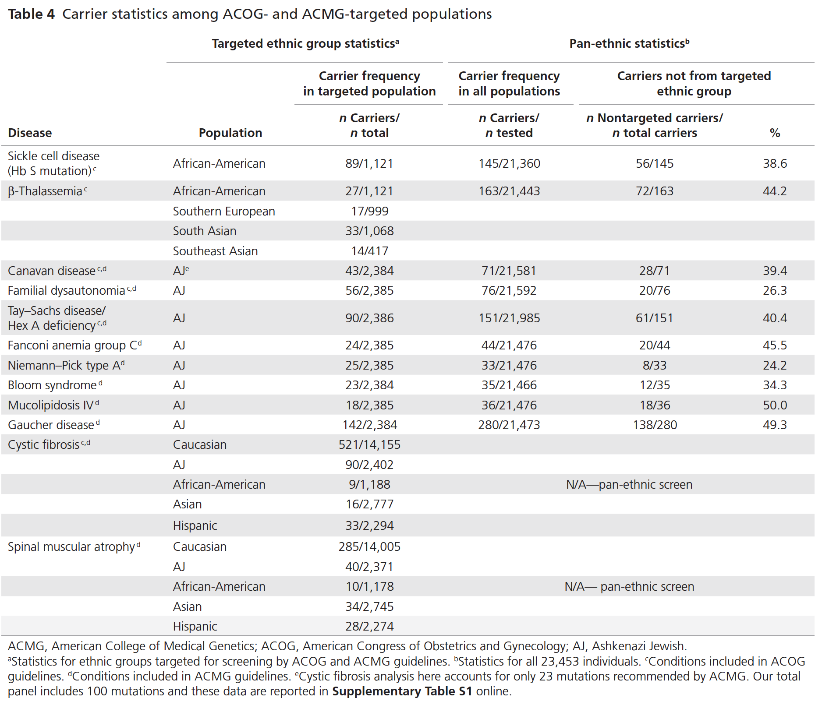

‘Founder Effects:’ Allele Frequency Differences Lead to Disease Frequency Differences
0.04
0.007
Genet Med 2013:15(3):178–186

Slide 16
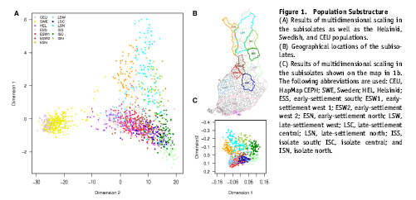
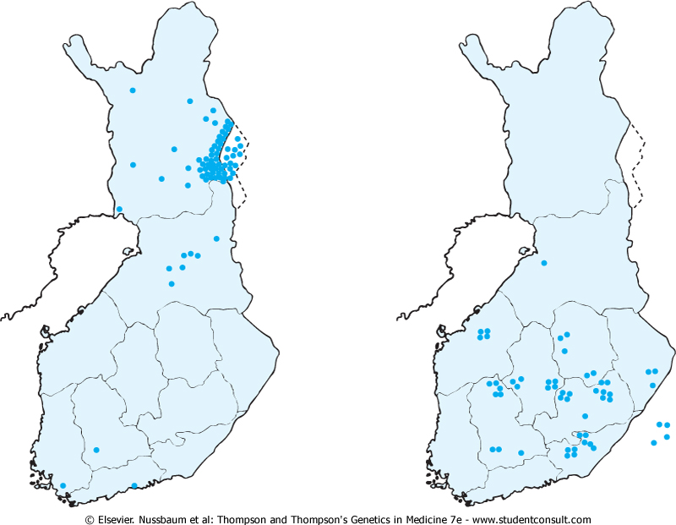
Population Genetic Substructure in Finland The population in Finland was originally quite isolated, and it expanded over 10-fold in the past 300 years. The isolation and population expansion allowed the population to develop a distinctive pattern of single-gene disorders.
Choroideremia
Hyperornithinemia
with Gyrate Atrophy
The geographical origin of cases of two genetic disorders prevalent in Finland: X-linked choroideremia (left) and hyperornithinemia with gyrate atrophy of the choroid and retina (right). Most cases of each disease originate from particular communities in Finland, but the distributions of the diseases differ. (Based on Mitchell GA, Brody LC, Sipila I, et al: At least two mutant alleles of ornithine-δ-aminotransferase cause gyrate atrophy of the choroid and retina in Finns. Proc Natl Acad Sci USA 86:197-201, 1989; and Nario R, Nevanlinna HR, Perheentupa J: Hereditary diseases in Finland: rare flora in rare soil. Ann Clin Res 5:109-141, 1973.)

Slide 17
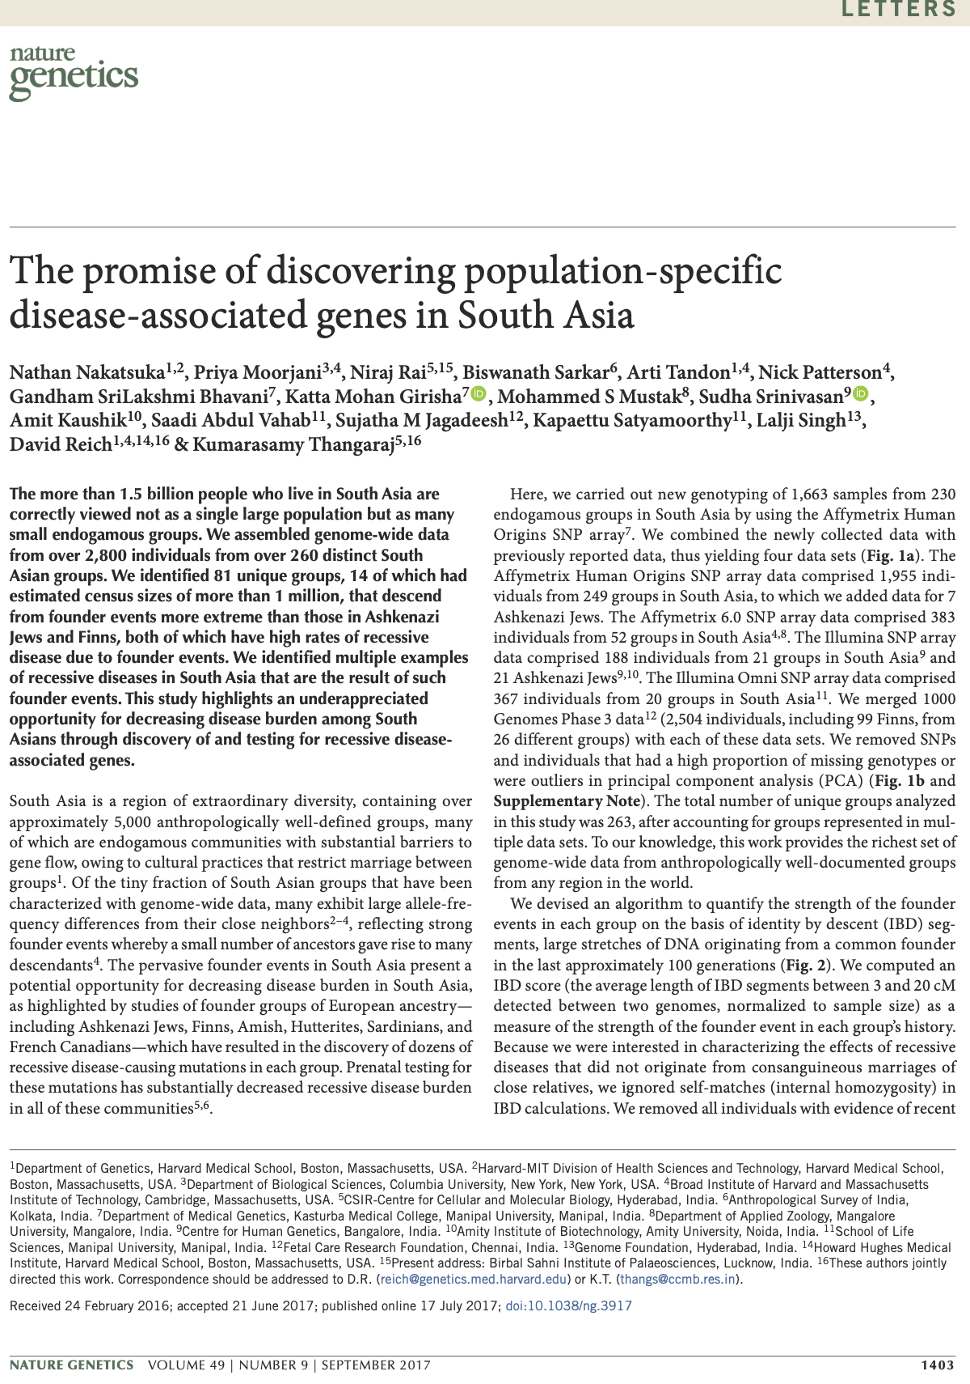
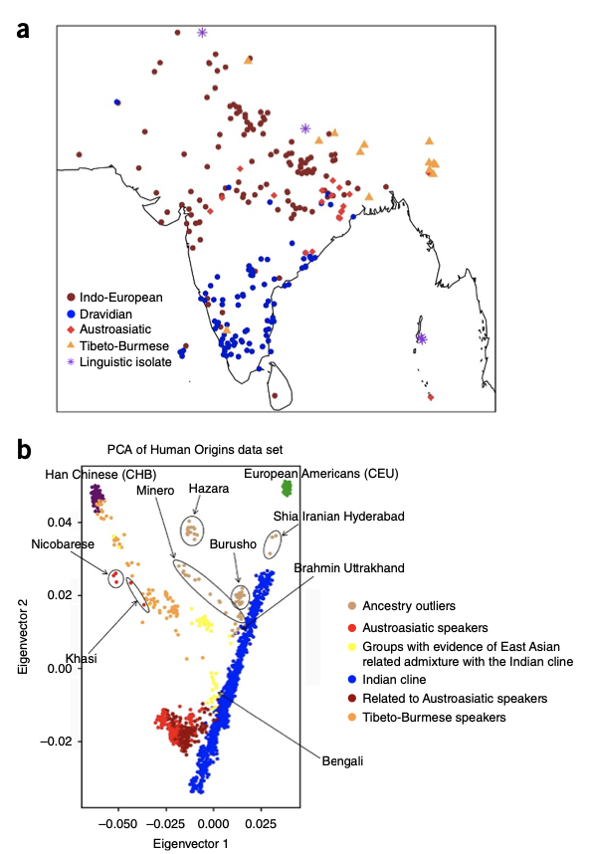
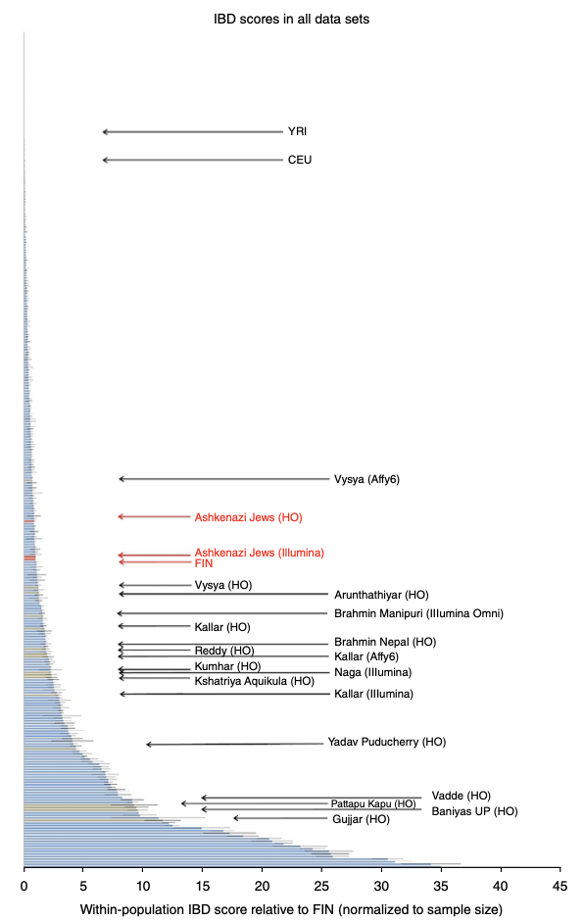
Population Genetic Substructure in India

Slide 18
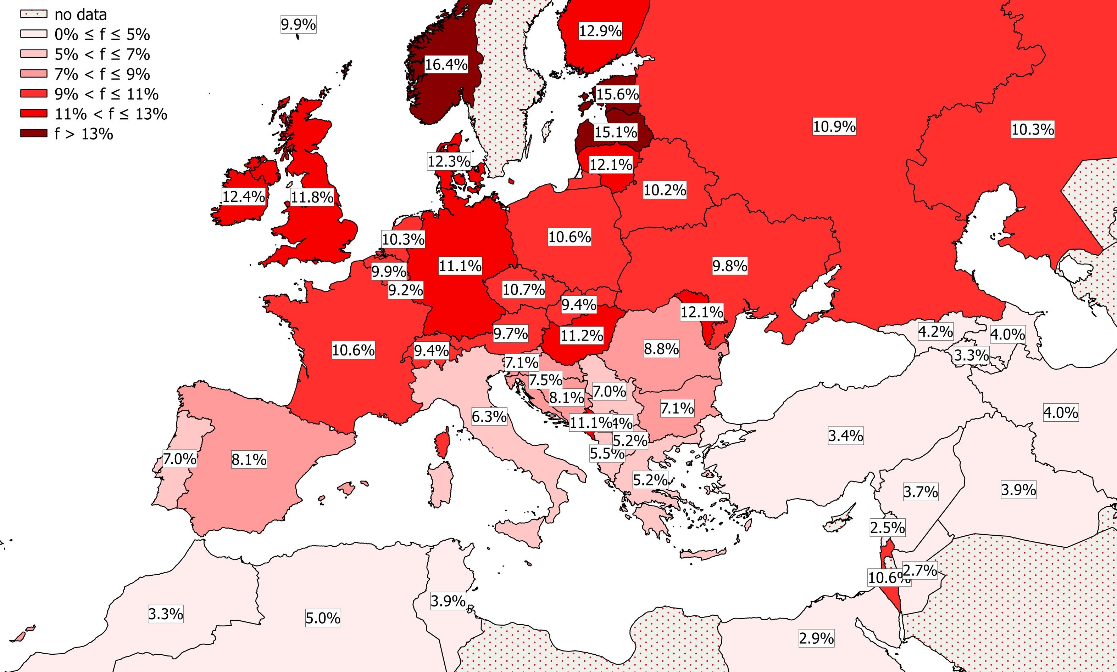
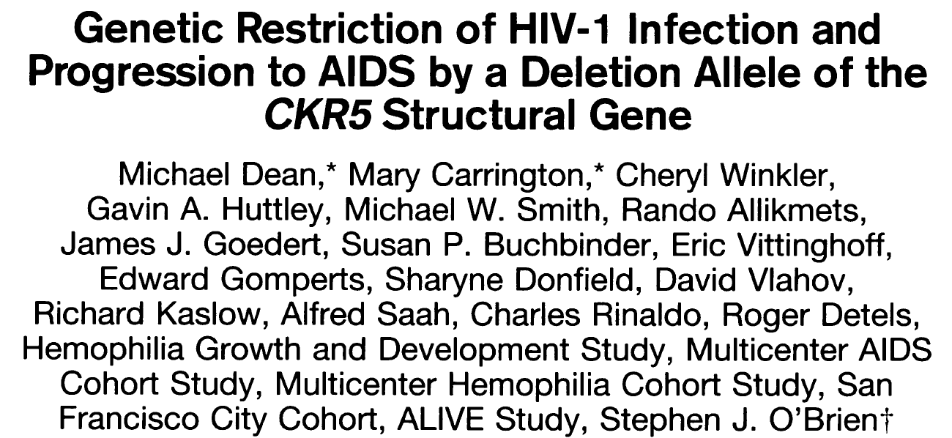
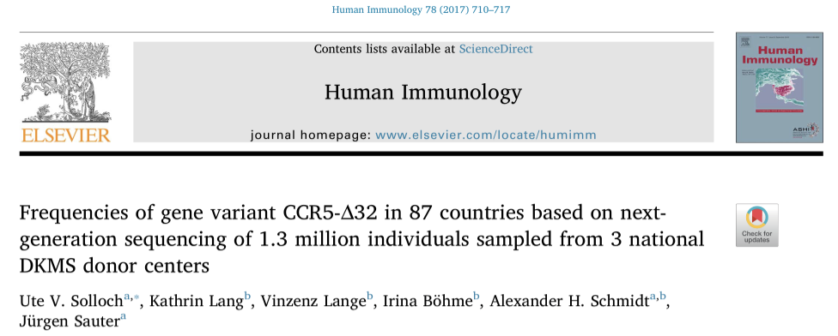
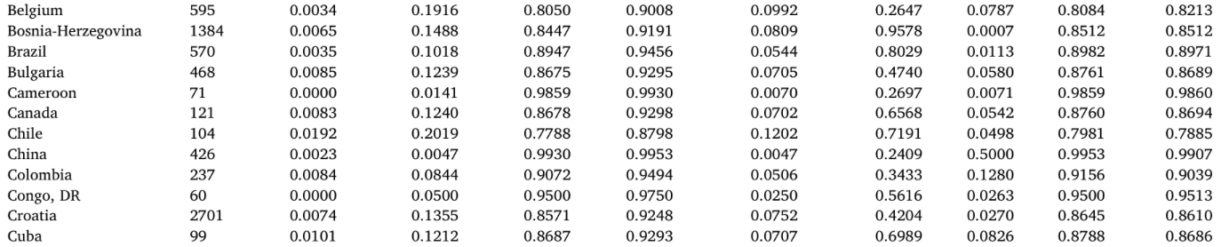
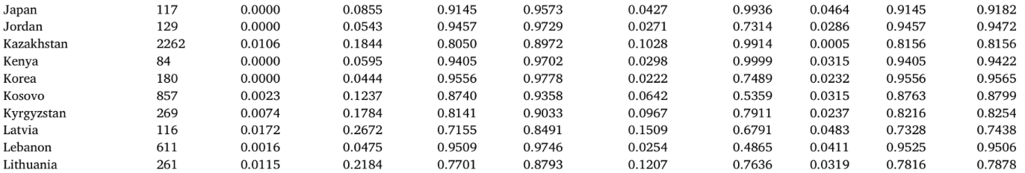
ΔCCR5 Variant Exhibits Global Frequency Differences
https://www.sciencedirect.com/science/article/pii/S0198885917305104

Slide 19
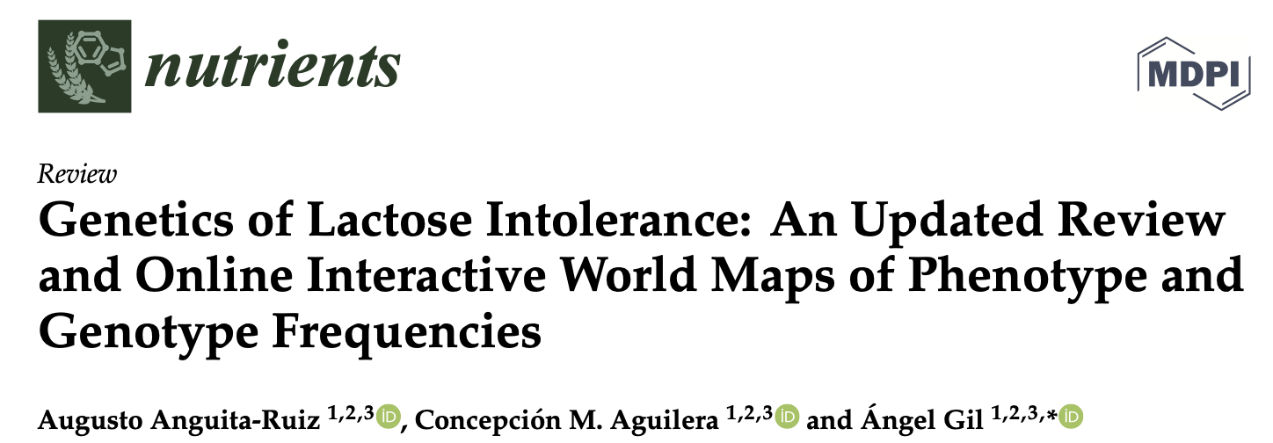
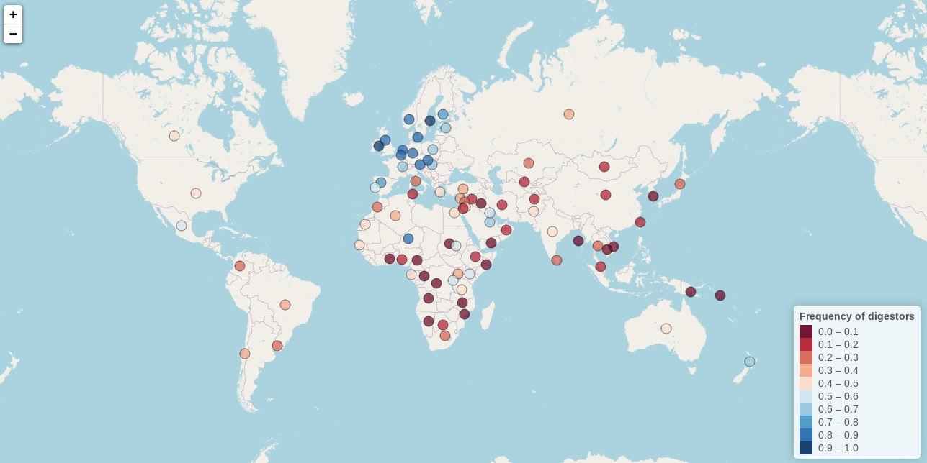
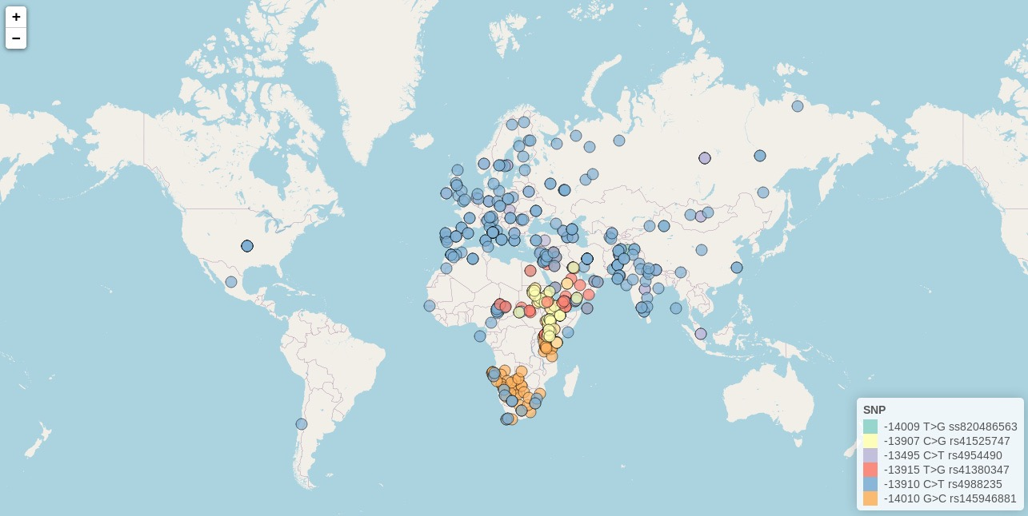
Lactose Intolerance and LPH Variant Frequency Differences
β-galactosidase enzyme called lactase-phlorizin hydrolase (LPH) influence digestion of milk
2/3 of humans have lactase non-persistence (LNP) and can’t digest milk
1/3 have lactase persistence (LP), are thus being able to digest milk during adulthood
LPH gene variants have undergone substantial selection

Slide 20

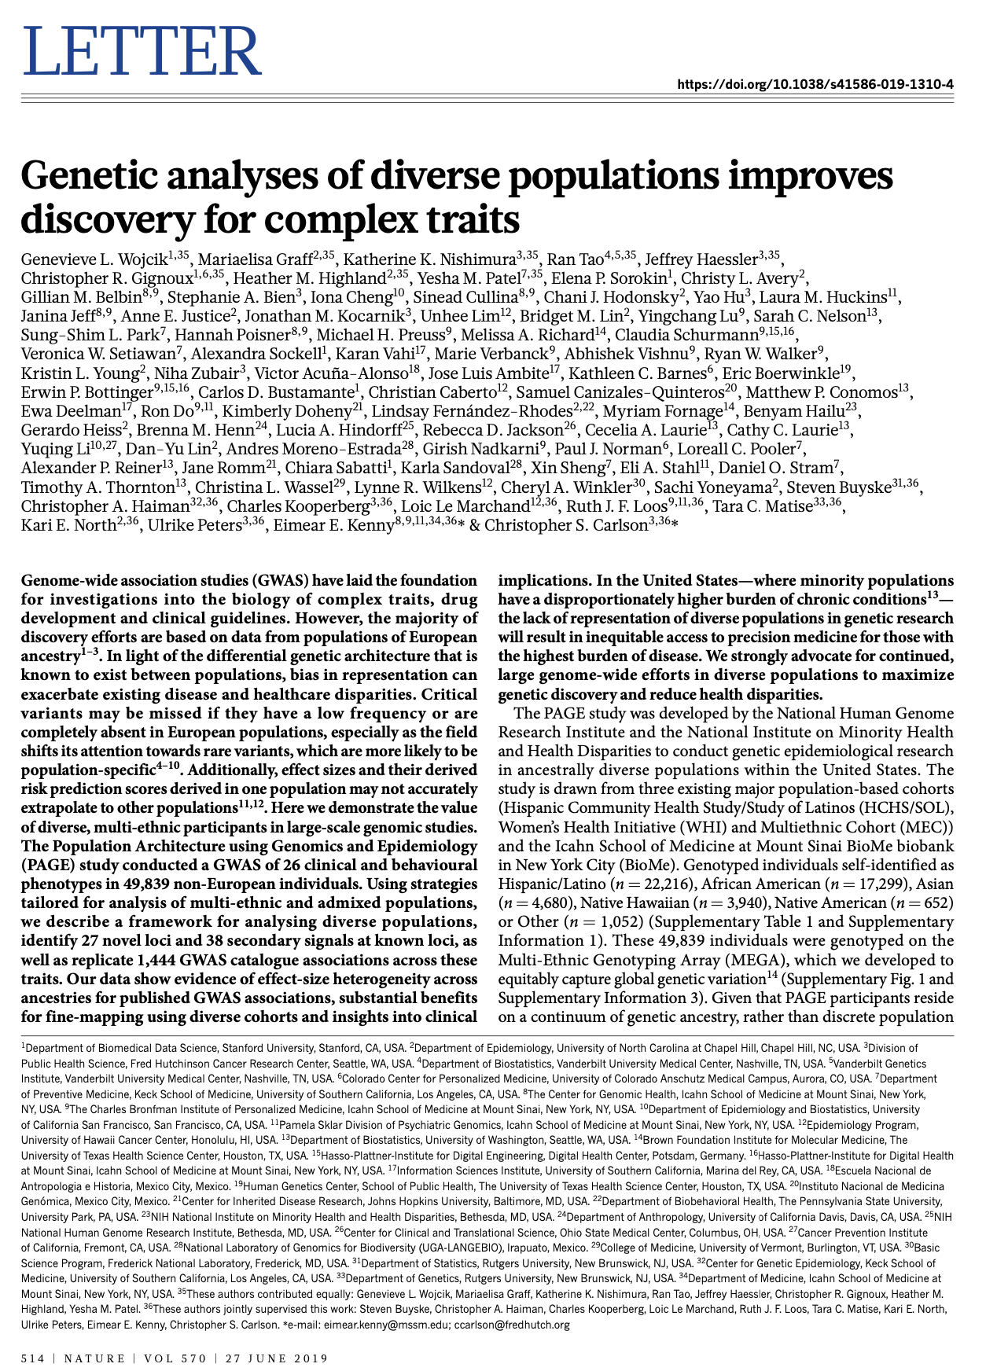

Most Genetics Research has been Pursued on Individuals of European Ancestry

Slide 21
2. Global Human Functional Genomic Diversity: Stratification and its Consequences

Slide 22


The Era of the Genome-Wide Association Studies (GWAS)
3,000+ Published Association Studies and 41,000+ SNP/Trait Associations and Growing…

Slide 23
GWAS “Hits” and Monogenic vs. Polygenic Phenotypes
'Monogenic’ = one primary ‘locus’ (likely a gene) harbors variants with very strong effects on the expression of trait
'Polygenic’ = many ‘loci’ harboring variants, each with weak effects on the expression of trait
Statistical Significance Threshold
Position in the Genome (i.e., Location on Chromosomes 1-21) Position in the Genome (i.e., Location on Chromosomes 1-21)

Slide 24

Polygenic Risk Scores and Their Relationship to Disease Risk
Average PRS = Average Risk
Lower PRS = Lower Risk (e.g., <3x average risk)
Higher PRS = Higher Risk (e.g., >3x average risk)
Timmers et al. eLife 2019;8:e39856
One can sum up the the number of the variants associated with a disease an individual possess:
Score = b₀ + w₁*v₁ + w₂*v₂ + … + w_{L}*v_{L} + error
‘Weights’ can be used to account for variable variant effects
The ‘score’ can be used to determine an individual’s risk of the disease (or contribute to a diagnosis)
This score has been referred to as a ‘Polygenic Risk Score’ (PRS)
PRS have been show to be very useful for assessing an individual’s risk in ways that either equal or outperform traditional monogenic variant tests
Less Variants Average Number More Variants
Polygenic Risk Score

Slide 25
PRS, Their Derivation and Genetic Correlations Between Diseases
Polygenic: Multiple Variants with Small Individual Effects, Large Cumulative Effect
…ACGTGCATGGACTAGCTAGAGGAGGCTCGAGATCGATAGCGGATACGAGCTAGCTGATACGATT…
Genetic correlation
Risk for 2nd disease
Risk for 1^{std} disease
Most PRS have been calculated for individuals of European descent
Age-related diseases are ‘genetically correlated;’ i.e., they share genetic determinants
Integrating genetic information (lifetime risks) with clinical evaluations (which gets at the current health state) is necessary to improve lifetime care

Slide 26



Transferability of PRS Compromised by Use of Single Ancestry Training Data
Myriad’s Breast Cancer PRS

Slide 27





Finding the Causative Variants for Idiopathic Disease: Filters
Two reasonable(?) assumptions:
The pathogenic variant(s) is ‘novel’ (i.e., unique to the patient)
The effect of the variant is pronounced enough to be characterized bioinformatically since there will be too many variants not functionally characterized via lab experiments
Novel Variant in Functional Element
…C G A T C A…
C G A T C A
1. Novel
2. Damaging
3. Relevant
Pathway
4. No
Compensatory
Mechanism
5. Pathogenic
Patient
Reference
genomes
…ACGCCGTCAGGGTCATAGTAGACTAGCTTGAGCTACCAAA…
…ACGTCGTCAGGGTCATCGTAGACTAGCTAGAGCTAGCATA…
…ACGTCGTCAGGCTCATAGTAGACTAGCTAGAGCTAGCATA…
…ACGTCGTCAGGCTCATAGTAGACTAGCTAGAGCTAGCAAA…
…ACGCCGTCAGGCTCATCGTAGACTAGCTAGAGCTAGCATA…
…ACGTCGTCAGGCTCATAGTAGACTAGCTAGAGCTAGCATA…
…ACGTCGTCAGGCTCATAGTAGACTAGCTAGAGCTAGCATA…
…ACGCCGTCAGGCTCATCGTAGACTAGCTAGAGCTACCATA…
…ACGTCGTCAGGCTCATCGTAGACTAGCTAGAGCTAGCATA…
…ACGCCGTCAGGCTCATAGTAGACTAGCTAGAGCTAGCATA…
…ACGTCGTCAGGCTCATCGTAGACTAGCTAGAGCTAGCAAA…
…ACGTCGTCAGGCTCATCGTAGACTAGCTAGAGCTACCATA…
G A T C
G A T
A T
T
What bioinformatic tools should be used for functionality? Does it make a difference?
What reference populations for determining novelty should be used? Does it matter?

Slide 28


Functional Annotations of Variants: Bioinformatic Predictions
Splice Change
Frameshift Structural Variants
Nonsense SNVs
Damaging ns cSNPs
Transcription
Factor Binding
Disrupting
Exonic Splicing
Silencer
Protein Motif Damaging
microRNA
Binding Site
Disrupting
Exonic Splicing
Enhancer
(Plumpton and Barnes. “Predictive Functional Analysis of Polymorphisms: An Overview.” in Bioinformatics for Geneticists. Wiley, 2007
Schork, Torkamani and colleagues: Bioinformatics 2008, 2009; Cancer Research (2009), Nat Gen Rev (2010), Genomics (2011))

Slide 29




Frequency of Functionally-Significant Variants Across Populations
http://archaeology.about.com/od/stoneage/ss/tishkoff_2.htm
CE=9
TS=4
JP=4
CH=4
MX=5
AS=5
GI=4
We compared the number of type of DNA sequence variants between individuals from different ethnic groups
Implications for comparing and contrasting individual genomes
LW=4
YR=9
MK=4

Slide 30
Regression Analyses Comparing Frequencies of All Functional Variant Types
Rate of Variant Type Per Genome: Negative Coefficient = Lower Rate; Positive = Higher Rate
Non-Africans differ from Africans in variant frequencies across virtually ALL functional variant categories
More variation in all functional elements in African genomes + More homozygous functional variation in non-African genomes

Slide 31


How Often Can One be Misled Using the Wrong Reference Data Set?
We ‘implanted’ known disease causative variants with Polyphen2 score > 0.8 in genomes
Determined the observed number of novel functional variants with different reference
Determining the novelty of a variant requires ancestry-appropriate reference genomes…
This has implications for clinical studies searching for variants for idiopathic conditions

Slide 32



Population-Level Genetic Differences Leads to Phenotypic Differences
Craniofacial Variation/Differentiation
Cavelaars 2000

Slide 33


Example low frequency populations
Example high frequency populations

Slide 34



Population-Level Genetic Differences and Brain Morphology

Slide 35




Historical Migratory Treks and Brain Morphology Differentiation
Hypothesis:
Brain size, as with skull size, shows variation consistent with historical migratory patterns in Europe (i.e., skull size and brain size are correlated but with what else?)
Two Data Sets:
Skulls obtained from individuals living in different European communities
Brain images from individuals whose ancestry was determined via genetic markers
Basic Analysis Strategy:
Correlate skull and brain size with major sources of population/individual genetic differentiation that reflect migratory patterns

Slide 36


Genetic Background/Ancestry Correlates with Cranial Structure
The more similar the genetic background, the more similar the cranial features
Martinez-Abadias 2009

Slide 37


Cranial Morphology Shows Correlations with Geolocation in Europe
1154 male skulls from 26 populations across Europe
N>10 skulls per population
37 neurocranial and facial length measurements
85% of skulls had complete data (all had at least 34/37)
Bakken, Dale, Schork, Human Heredity (2011)

Slide 38

Several Cranial Features Vary Along NW–SE Axis (Migratory Trek)
Bakken, Dale, Schork, Human Heredity (2011)
Notes:
Sokal1987 see an increase in cranial length (GOL) along this axis too

Slide 39

Several Neural Tissue Features Vary Along NW-SE Axis (Migratory Trek)
Hemi | Lobe | Region | P-value
R | Frontal | lateralorbitofrontal | 1E-06
R | Temporal | superiortemporal | 2E-06
R | Frontal | rostralmiddlefrontal | 5E-05
R | Occipital | lateraloccipital | 6E-05
L | Temporal | superiortemporal | 8E-05
L | Cingulate | rostralanteriorcingulate | 1E-04
R | Frontal | caudalmiddlefrontal | 1E-04
L | Frontal | superiorfrontal | 2E-04
L | Frontal | lateralorbitofrontal | 2E-04
R | Temporal | transversetemporal | 2E-04
L | Frontal | parsopercularis | 3E-04
L | Occipital | lateraloccipital | 4E-02
R | Cingulate | rostralanteriorcingulate | 2E-01
Southeast -> Northwest Gradiant
Covariates: Age, sex, diagnosis, height, BMI (these effects were eliminated!)
No association with: hippocampal volume, cortical thickness, cerebellar volume
Bakken, Dale, Schork, Human Heredity (2011)

Slide 40

Frontotemporal Regions Are Most Associated with NW-SE Gradient
Color maps that indicate nominal -log10(P-value) of association between NW–SE admixture and cortical area across the reconstructed cortical surface, while controlling for height, weight, BMI, age, sex, and diagnosis.
Bakken, Dale, Schork, Human Heredity (2011)

Slide 41


Ancestry Effects on Neuroimaging-Guided Pediatric Diagnoses

Slide 42
Ancestry Effects on Neuroimaging-Guided Pediatric Diagnoses
Figure 2: Age and sex adjusted distribution of total cortical area and mean cortical thickness in individuals with various genetic ancestry.
Bloss et al. (2012) UCI International Imaging Genetics Conference

Slide 43
Population Stratification and False Positive Associations
Population 1 Population 2
-
-
-
+
-
+
+
+
+
-
-
+
-
-
+
+
-
+
+
+
-
+
-
+
-
-
+
+
-
+
-
-
+
+
-
-
-
-
+
-
+
-
-
+
+
+
+
-
-
+
Diseased = Shaded: ; Non-Disease = Non-Shaded:
Differential frequency of the +/- alleles between the populations
+
+
+
+
+
+
-
-
-
-
-
-
Cases Controls
(+: 6/6) (+: 0/6)

Slide 44


Population Stratification and False Positive Associations

Slide 45


The Transmission Disequilibrium Test (TDT)
TA
AA
The TDT tests the frequency with which a particular allele is transmitted to an affected offspring from a heterozygous parent (normally 50% probability)
The TDT requires no control group (the untransmitted allele is thus the ‘control’)
TA
By not requiring a control group, the TDT avoids the problem of stratification for genetic association studies
In addition, the TDT avoids the need to identify appropriate controls
However, the TDT does not easily accommodate epidemiologic investigations involving multiple genetic and non-genetic factors or interactions

Slide 46

Using Principal Components to Correct for Population Stratification
DV = b₀ + b₁*CC + B₂*PC₁ + … + PC_{L} + error
DV: Dependent Variable (e.g., disease diagnosis)
CC: (0 = no disease; 1 = disease)
PC: Principal Component
b_{x}: Regression Coefficient

Slide 47
3. Admixture: Characterization, Consequences and Admixture Mapping

Slide 48
Using Genetic Variation to Trace Migration and Admixture

Slide 49

Estimating ‘Degree’ of Admixture Using Ancestry Informative Markers (AIMs)
Genetic variants that are unique to, or more common in, certain populations have been identified
Panels of markers that have such “population specific alleles” in them have been devised
These markers are “ancestry informative” for the population they have been chosen for based on their being unique or more common in that population
An individual can be genotyped for these markers
The fraction of variants an individual possesses that are associated with the population in question is an estimate of the degree of ancestry for that person for that population
Repeating this for many population specific AIMs can be used to estimate how “admixed” an individual is
AJHG (1995) 63:1839-1851

Slide 50





Estimating ‘Degree’ of Admixture Using Ancestry Informative Markers (AIMs)
Chicago African Americans
(Halder, Shriver, et al. unpublished)
Costa Ricans
(Shriver, et al. unpublished)
African Americans have genomes ‘between’ West Africans and Europeans but vary in degree of admixture
Costa Ricans have genomes ‘between’ Native Americans and Europeans but vary in degree of admixture

Slide 51

Genealogical Testing, Henry Louis Gates and the Infamous Beer Summit

Slide 52




Skin Color can be a Very Poor Proxy for Ancestry, Especially Among Admixed
Global map of skin pigmentation levels

Slide 53



Admixture Mapping: Exploiting Degree of Admixture in Association Studies
Hypothesis: differences in disease rates between two ancestral populations are due in part to frequency differences in disease-causing genetic variants.
Causative genetic variants occur more often on chromosome segments inherited from the ancestral population with the higher disease variant frequency among individuals admixed from the two ancestral populations.

Slide 54


Correlation Between Degree of Admixture and Phenotypes
Human Heredity (2014) 77:73-86

Slide 55
Ancestry, Genetic Background, and Drug Prescriptions
Individuals from different ancestral groups respond differently to drugs
It is thought that this is due to genetic differences
Historically, race (more so skin color) was used as a guide for determining which drug a patient should receive
Propranolol (antihypertensive) responses differ between races

Slide 56



The Correlation Between Native American Ancestry and Body Mass Index
Native Americans (NAs) have different body habitus and morphology than non-NAs
Body Mass Index (BMI) is thought to have a polygenic basis
NA communities exhibit genetic differentiation from non-NA communities
Many communities have admixed individuals (i.e., offspring from matings between, e.g., NA/non-NA)
Many cultural factors influence BMI (e.g., diet, lifestyle)
864 individuals from a Native American Community
BMI was measured on each individual
Two measures of genetic marker-informed NA ancestry:
Genetic cluster-based ADMIXTURE analysis (‘ADMIXTURE’)¹
Supervised 4 population-based ancestry assignments (‘ANC4’)²
Two measures of NA cultural identity:
Indian Culture Scale (‘ICS’)
Orthogonal Cultural Identification Scale (‘OCIS’)
Other covariates included: self-reported NA ancestry, sex, income and education
Notes:
Mahalanobis distance

Slide 57


The Correlation Between Native American Ancestry and Body Mass Index
The Correlation Between Native American Ancestry and Body Mass Index

Slide 58



Admixture Mapping of BMI-Associated Variants in African Americans
PLoS Genetics (2009) 5:5

Slide 59


Commercial Ancestry Assessment Offerings

Slide 60
The Watson Genome, Genetic Background and Irony

Slide 61




The Watson Genome, Genetic Background and Irony

Slide 62
4. Population Genetics and Evolutionary Genetics: Integration and Impact

Slide 63



How is Genotypic/Phenotypic Differentiation Maintained?
(population genetics, speciation, and mutation rates)
How do species develop? Via the compilation of functionally-significant mutations and selection/adaptation?
The mutation rate would have to be too high to explain all variation exhibited by a species
Sewall Wright devised brilliant theorems to explain the emergence of new phenotypes, speciation, and adaptive forces (The “Shifting Balance of Evolution Theory”).
Wright’s Theory Emphasizes:
Random processes, not directed processes
Combinations of mutations, not new mutations
Epistasis not single gene actions

Slide 64
(Random) Genetic Drift
(Sewall Wright)
C
A
A
T
C
G
An event leading to
subdivision occurs
T
G
T
T
A
A
C
G
T
G
T
A
A
A
T
A
T
C
T
T
A
G
T
C
A
A
A
A
C
C
A
C
A
A
A
G
T
A
T
C
Unique
Environments
A
G
C
T
T
A
T
C
T
C
A
C
C
T
G
T
T
G
T
T
A
C
C
C
T
T
A
T
T
T
T
C
C
C
T
C
T
C
T
C
A
T
T
Contemporary
Population
1
2
3
4
5
6
Time
T-frequency
25%
80%
50%
17%
0%
20%
Novel Phenotypes AAA TTTT CCTT CCTT - -

Slide 65


Measuring Natural Selection within the Human Population via Differentiation
Lactase Gene (LCT)
https://en.wikipedia.org/wiki/Selective_sweep#/media/File:SoftSGVSelectiveSweep.jpg

Slide 66




Greenlandic Inuit and Diet and Climate Adapations

Slide 67






Human Neandertal Admixture: Ancient Phenotype-Genotype Variants

Slide 68

Evolutionary (or Darwinian) Medicine
Functional and/or mechanistic explanations for disease from an evolutionary perspective
(e.g., address the question “why does disease exist?”)
The Thrifty Genotype Hypothesis:
Neel JV (1962). Diabetes mellitus: a "thrifty" genotype rendered detrimental by "progress“? Am J Hum Genet. Dec;14:353-62.
Stannard SR, Johnson NA (2004). Insulin resistance and elevated triglyceride in muscle: more important for survival than "thrifty" genes? J Physiol. Feb 1;554 (Pt 3):595-607.
Maladaptive Stress Response:
Korte SM, Koolhaas JM, Wingfield JC, McEwen BS (2005). The Darwinian concept of stress: benefits of allostasis and costs of allostatic load and the trade-offs in health and disease. Neurosci Biobehav Rev. Feb;29(1):3-38.
Whybrow PC (2005). American Mania: When More Is Not Enough. New York: W. W. Norton & Company.
Wiesenfeld SL (1967). Sickle-cell trait in human biological and cultural evolution. Development of agriculture causing increased malaria is bound to gene-pool changes causing malaria reduction. Science. 157(793):1134-40.
Williams N (2003). Evolution and disease. Curr Biol. 2003 Jan 8;13(1):R3-4.

Slide 69


Evolutionary (or Darwinian) Medicine

Slide 70
Questions?

